Slide 1
Hardware
08-04-2024

Slide 2
Embedded CPU: EdaTec CM4 Sensing
CM4 based compute
We choose 4 GB RAM, 8 GB eMMc, Wifi/Bluetooth on
Add a 128 GB SD Card for the data
Contains an RTC based clock
Contains a 4G/LTE module
Contains the capability to read an SD card next to the eMMc
Missing:
UPS (for power outage) module
Open questions long term:
Do we need the 8 or 4 GB RAM version, do we need Wifi, do we need more cooling

Slide 3
Storage use
eMMc
SD-card
Contains the OS and essential services
Contains the Docker engine
Contains the core Docker Image
Contains the home directory
Contains data and logging
Contains the containers
Does not contain a Rpi image

Slide 4
Additions to the module
A plate with the Plense logo blocking off usb/Hdmi ports
An extra part over the RS-485 and 12V stick out containing the 12V cable splitter, two wartels (1 for the RS485 out and 1 for the 12V in)

Slide 5
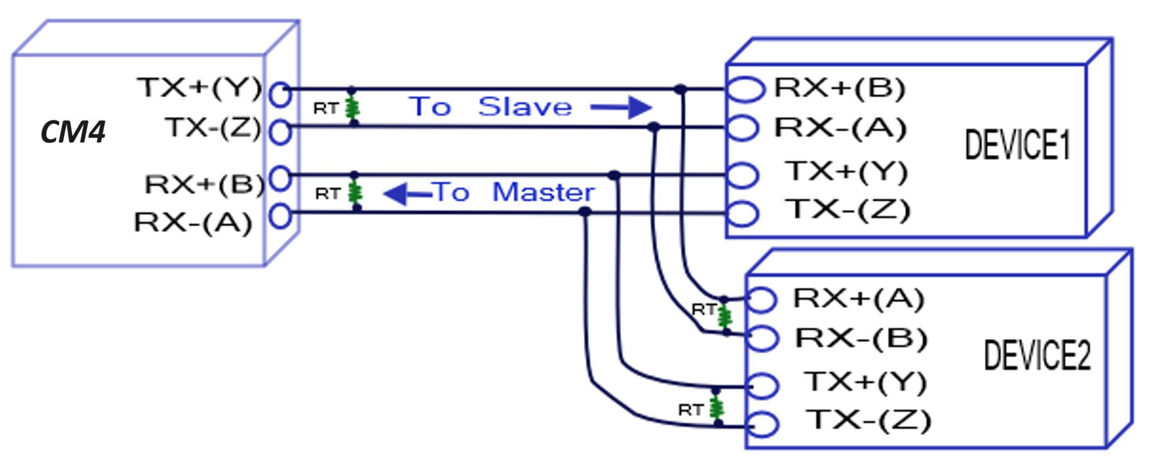
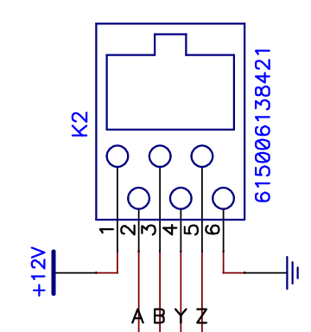
Wiring RS485, we need two UART channels
NOTE: we need AMA2 for RS485-1 and AMA3 for RS485-2,
For an extra one we would need AMA1 (3) and AMA4 (4)

Slide 6
Current use per sensor
Not more than 30 mA
Max current we can apply over the wire: 1 A
The ear and main RS485 connectors are already switched so we do not have to twist the wires to connect receiver to transmitter and vice versa
The grounds on the EdaTec are all connected

Slide 7
Important questions
Do we see clock frequency throttling
Internal temperature
Not enough current supplied
Underclock if possible?

Slide 8
Required materials
3D printer?
Foam
Waterproof 2/3A 12VDC chargers
If the EdaTec works well
12V cable splitter
Print protecting the RS ports
TODO 3D print design
How to make the SHT touch outside air and protect insides

Slide 9
Supplementary information

Slide 10
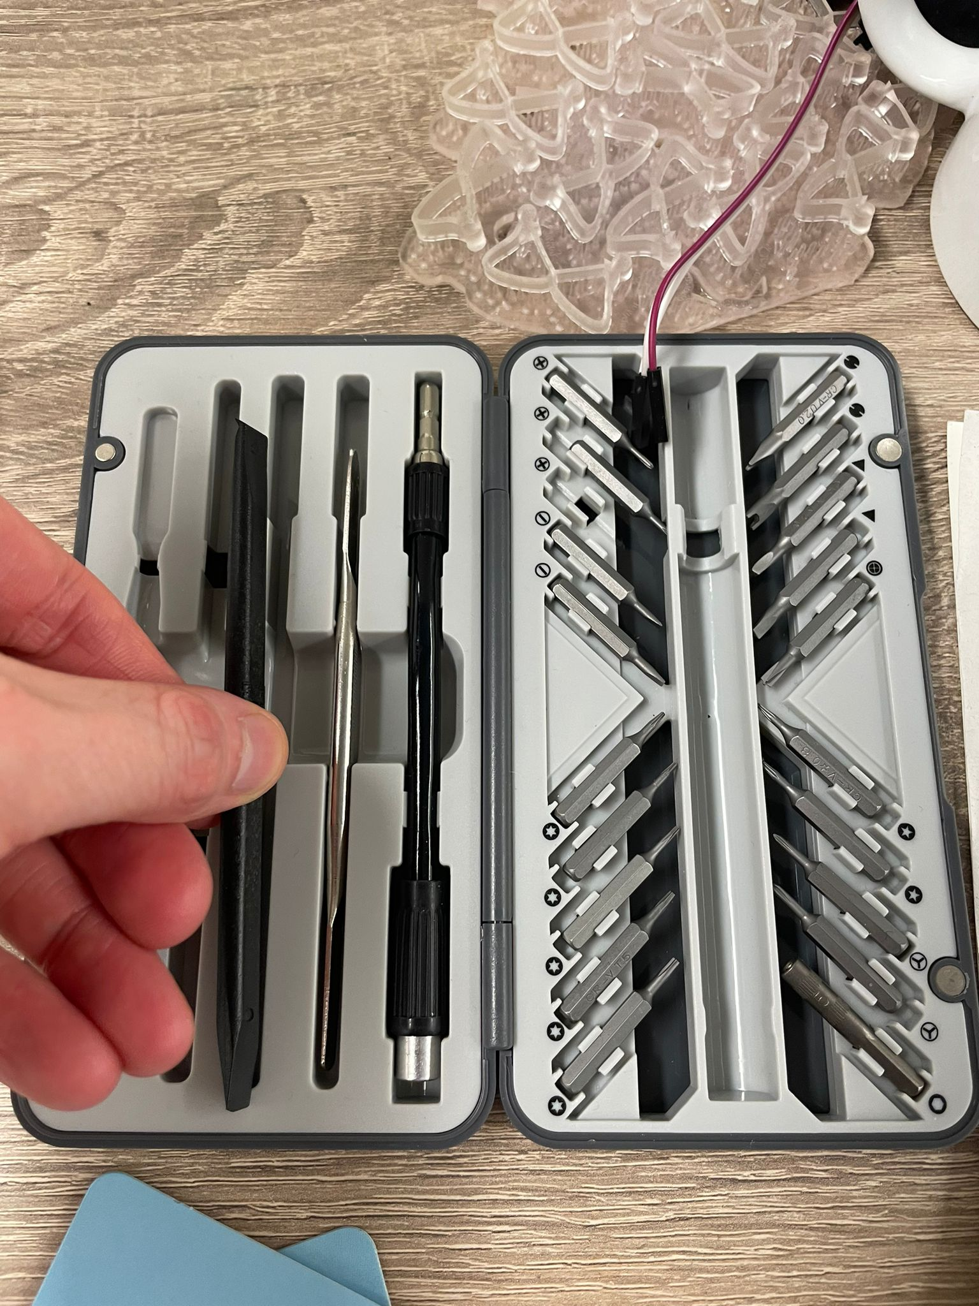
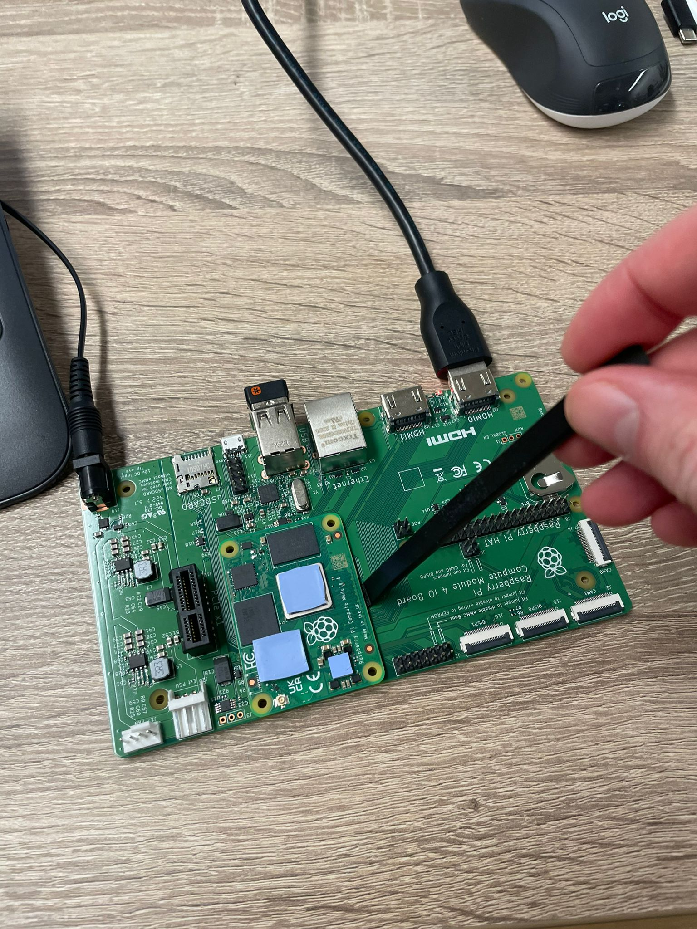
Handling the CM4: use plastic tool

Slide 11
Possible settings to implement
We can turn off a lot of power and CPU consuming components
Make sure the Pi doesn’t heat up too much
Underclock
Use htop to see which components use a lot of memory/cpu
Ethernet controller generates a lot of heat
Importance of different tasks

Slide 12
Formatting the CM4 emmc
Put the CM4 into the IO Board, connect the jumper on J2: disable eMMc Boot, connect the USB slave micro USB to your PC
Download Raspberry Pi Imager and USB booter, follow this guide:
Raspberry Pi Documentation - Compute Module hardware
Download and run the Windows installer to install the drivers and boot tool
Plug your host PC USB into the USB slave port, making sure you have setup the board
Apply power to the board; Windows should now find the hardware and install the driver
Once the driver installation is complete, run the RPiBoot.exe tool
After a few seconds, the Compute Module eMMC will pop up under Windows as a disk
Install the OS using the Pi imager and a custom OS from your PC (Edatec image)
Upon errors on unknown capacity of the “SD-card” as recognized by your PC, reformat using:
On Windows go to “Create and format hard disk partitions”, select your SD card and right click the unallocated region, “New simple volume” and continue the prompts

Slide 13
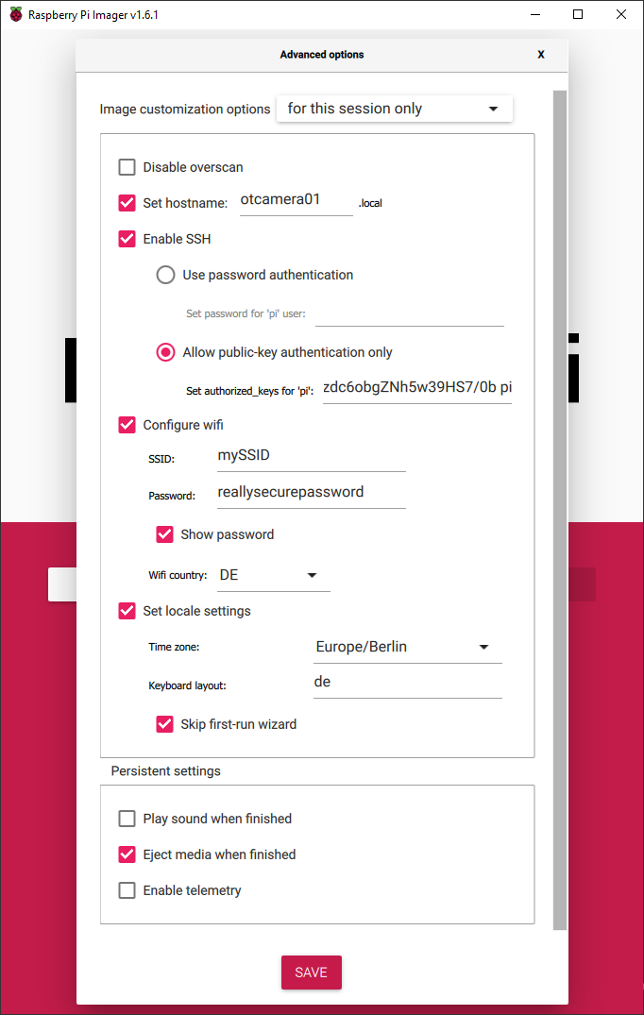
Creating new Pi images
Use a 8 GB eMMc Pi
Partition into x<<8 GB
Download Win32 Disk Imager
Enter Boot mode for the CM4, run the USB booter (rpiboot). Once you see the pi as a disk open Win32 Disk Imager
Select the device, set a image file location and name, enable Read only allocated partitions
Click read
A new image for other Pi’s can be build using the Raspberry Pi Imager
Make sure to use advanced settings to already set the name, timezone etc.

Slide 14
Content of the image
The right Pi settings
Enabled SSH, serial comms, Bluetooth off and all other peripherals …
Fully updated software
VS Code
Greengrass

Slide 15
Where we want to go
Make a base image with the right configurations, image with the right host name and SSH on, AWS Greengrass already installed, the right unique IP Address
A master script looping through X Pi’s giving them the right name and default AWS Greengrass setup
Is there a way to fully configure Greengrass already in the master script?
Only OS on the eMMc and only data on the SD card
Update raspi-config (on EEPROM) to always boot from eMMc first using the rpi-eeprom-update tool in the master script

Slide 16
Message format
Start byte,
1 byte,
0x5A
Sensor ID,
3 bytes,
Ex.: 0x3C2A1B
Payload length,
2 bytes,
Ex.: 0x01
Payload,
N bytes,
Ex. 0x5B
Checksum,
1 byte

Slide 17
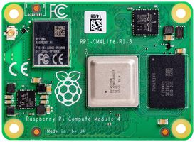
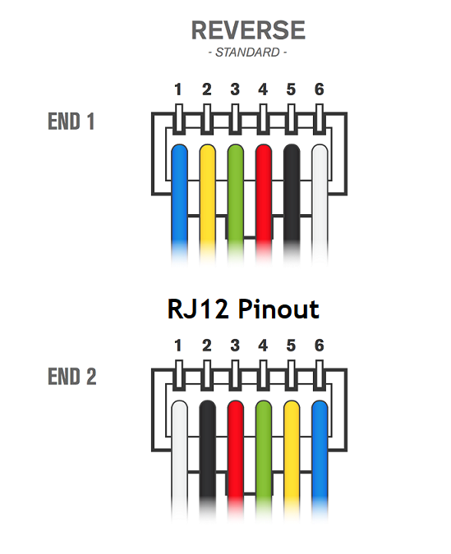


Sensor layout
Compute module
Sensor 1
Sensor 2
Sensor 30

Slide 18

Input signals
Block wave & Time-of-flight
Sine sweep
Start
Frequency
Stop
Frequency
Start
Frequency
Stop
Frequency
Fixed 10V amplitude
10 ms:
No input but still measurement
Fixed 10V
amplitude
Duration
Duration

Slide 19
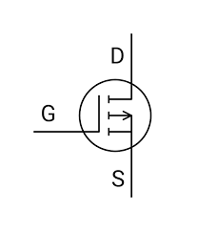
Reset function
Power
Splitter
CM4
12 V
3 A
12 V
1.5 A
RS485 - 2
RS485 - 1
12V
Sens
P-CH mosfet
Sensor
12V, 1.5 A
CM4GPIO
12V
POW

Slide 20
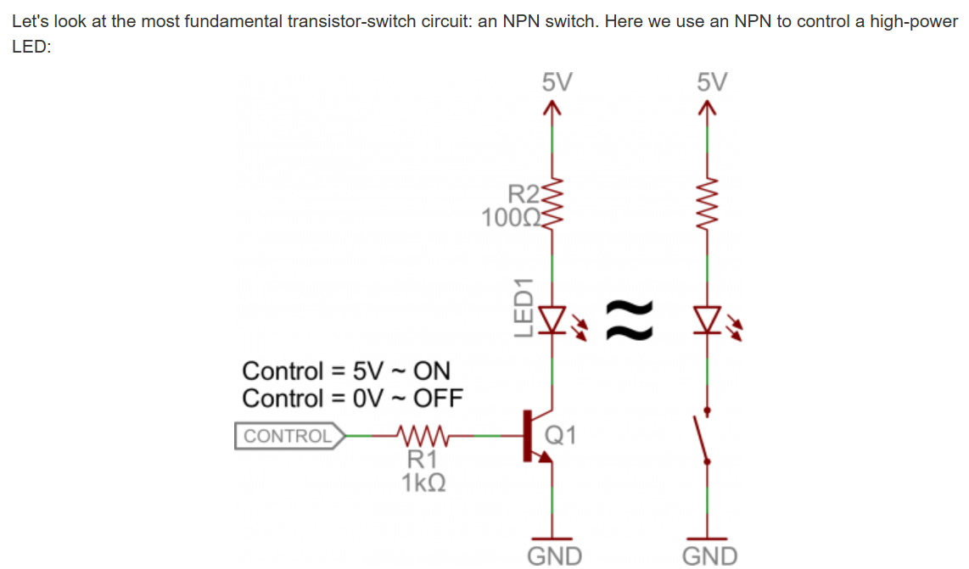
Control using RTS RS232

